Slide 1
Bresenham's line algorithm
Accurate and efficient
Uses only incremental integer calculations
The method is described for a line segment with a positive slope less than one
The method generalizes to line segments of other slopes by considering the symmetry between the various octants and quadrants of the xy plane

Slide 2
Bresenham's line algorithm
Decide what is the next pixel position
(11,11) or (11,12)
13
Specified
line path
12
11
10
10
11
12
13

Slide 3
Illustrating Bresenham’s Approach
For the pixel position x_{k+1}=x_{k}+1, which one we should choose:
(x_{k+1},y_{k}) or (x_{k+1}, y_{k+1})
y_{k+3}
y_{k+2}
y=mx+b
y_{k+1}
y_{k}
x_{k}
x_{k+1}
x_{k+2}
x_{k+3}

Slide 4
Bresenham’s Approach
y=m(x_{k} + 1)+b
d_{lower}=y-y_{k}
=m(x_{k} + 1)+b-y_{k}
d_{upper}=(y_{k}+1)-y
= y_{k}+1 -m(x_{k} + 1)-b
y_{k+1}
d_{upper}
y
d_{lower}
y_{k}
x_{k+1}
d_{lower}- d_{upper}= 2m(x_{k} + 1)+2y_{k}+2b-1
Rearrange it to have integer calculations:
m=Δy/Δx
Decision parameter: p_{k}= Δx(d_{lower}- d_{upper})=2Δy.x_{k} - 2Δx. y_{k} + c

Slide 5
The Decision Parameter
Decision parameter: p_{k}= Δx(d_{lower}- d_{upper})=2Δy.x_{k} - 2Δx. y_{k} + c
p_{k} has the same sign with d_{lower}- d_{upper} since Δx>0.
c is constant and has the value c= 2Δy + Δx(2b-1)
c is independent of the pixel positions and is eliminated from decision parameter p_{k}.
If d_{lower}< d_{upper} then p_{k} is negative.
Plot the lower pixel (East)
Otherwise
Plot the upper pixel (North East)

Slide 6
Succesive decision parameter
At step k+1
p_{k+1}= 2Δy.x_{k+1} - 2Δx. y_{k+1} + c
Subtracting two subsequent decision parameters yields:
p_{k+1}-p_{k}= 2Δy.(x_{k+1}-x_{k}) - 2Δx. (y_{k+1}-y_{k})
x_{k+1}=x_{k}+1 so
p_{k+1}= p_{k} + 2Δy - 2Δx. (y_{k+1}-y_{k})
y_{k+1}-y_{k} is either 0 or 1 depending on the sign of p_{k}
First parameter p₀
p₀=2 Δy - Δx

Slide 7
Bresenham's Line-Drawing Algorithm for I m I < 1
1. Input the twoline endpoints and store the left endpoint in (x₀ ,y₀).
2. Load (x₀ ,y₀) into the frame buffer; that is, plot the first point.
3. Calculate constants Δx, Δy, 2Δy, and 2Δy - 2Δx, and obtain the starting value for the decision parameter as
p₀=2 Δy - Δx
4. At each x_{k} along the line, starting at k = 0, perform the following test:
If p_{k} < 0, the next point to plot is (x_{k+1}, y_{k}) and
p_{k+1}=p_{k} + 2Δy
Otherwise, the next point to plot is (x_{k+1}, y_{k+1}) and
p_{k+1}=p_{k} + 2Δy - 2Δx
5. Repeat step 4 Δx -1 times.

Slide 8
Trivial Situations: Do not need Bresenham

Slide 9
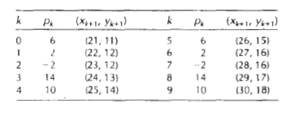
Example
Draw the line with endpoints (20,10) and (30, 18).
Δx=30-20=10, Δy=18-10=8,
p₀ = 2Δy – Δx=16-10=6
2Δy=16, and 2Δy - 2Δx=-4
Plot the initial position at (20,10), then

Slide 10
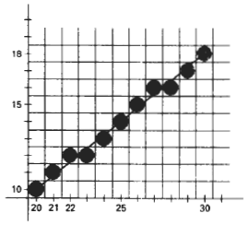

Slide 11
Example
Line end points:
Deltas:
initially

Slide 12
Graph
13
12 11 10 9 8 7 6
4 5 6 7 8 9 10 11

Slide 13
Continue the process...
13
12 11 10 9 8 7 6
4 5 6 7 8 9 10 11

Slide 14
Graph
13
12 11 10 9 8 7 6
4 5 6 7 8 9 10 11

Slide 15
Graph
13
12 11 10 9 8 7 6
4 5 6 7 8 9 10 11

Slide 16
Graph
13
12 11 10 9 8 7 6
4 5 6 7 8 9 10 11

Slide 17
/* Bresenham line-drawing procedure for |m| < 1.0. */
void lineBres (int x0, int y0, int xEnd, int yEnd)
{
int dx = fabs (xEnd - x0), dy = fabs(yEnd - y0);
int x, y, p = 2 * dy - dx;
int twoDy = 2 * dy, twoDyMinusDx = 2 * (dy - dx);
/* Determine which endpoint to use as start position. */
if (x0 > xEnd) {
x = xEnd; y = yEnd; xEnd = x0;
}
else {
x = x0; y = y0;
}
setPixel (x, y);
while (x < xEnd) {
x++;
if (p < 0)
p += twoDy;
else {
y++;
p += twoDyMinusDx;
}
setPixel (x, y);
}
}

Slide 18
Line-drawing algorithm should work in every octant, and special cases
m<-1
m>1
0>m>-1
0<m<1
0<m<1
0>m>-1
m>1
m<-1

Slide 19
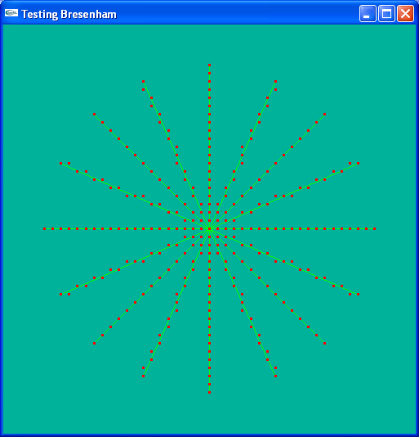
Simulating the Bresenham algorithm in drawing 8 radii on a circle of radius 20
Horizontal, vertical and ±45° radii handled as special cases

Slide 20
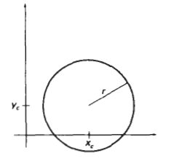
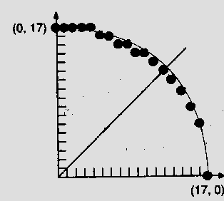
Scan Converting Circles
Explicit: y = f(x)
We could draw a quarter circle by incrementing x from 0 to R in unit steps and solving for +y for each step.
Method needs lots of computation, and gives non-uniform pixel spacing

Slide 21
Scan Converting Circles
Parametric:
Draw quarter circle by stepping through the angle from 0 to 90
avoids large gaps but still unsatisfactory
How to set angular increment
Computationally expensive trigonometric calculations

Slide 22
Scan Converting Circles
Implicit: f(x,y) = x²+y²-R²
If f(x,y) = 0 then it is on the circle.
f(x,y) > 0 then it is outside the circle.
f(x,y) < 0 then it is inside the circle.
Try to adapt the Bresenham midpoint approach
Again, exploit symmetries

Slide 23
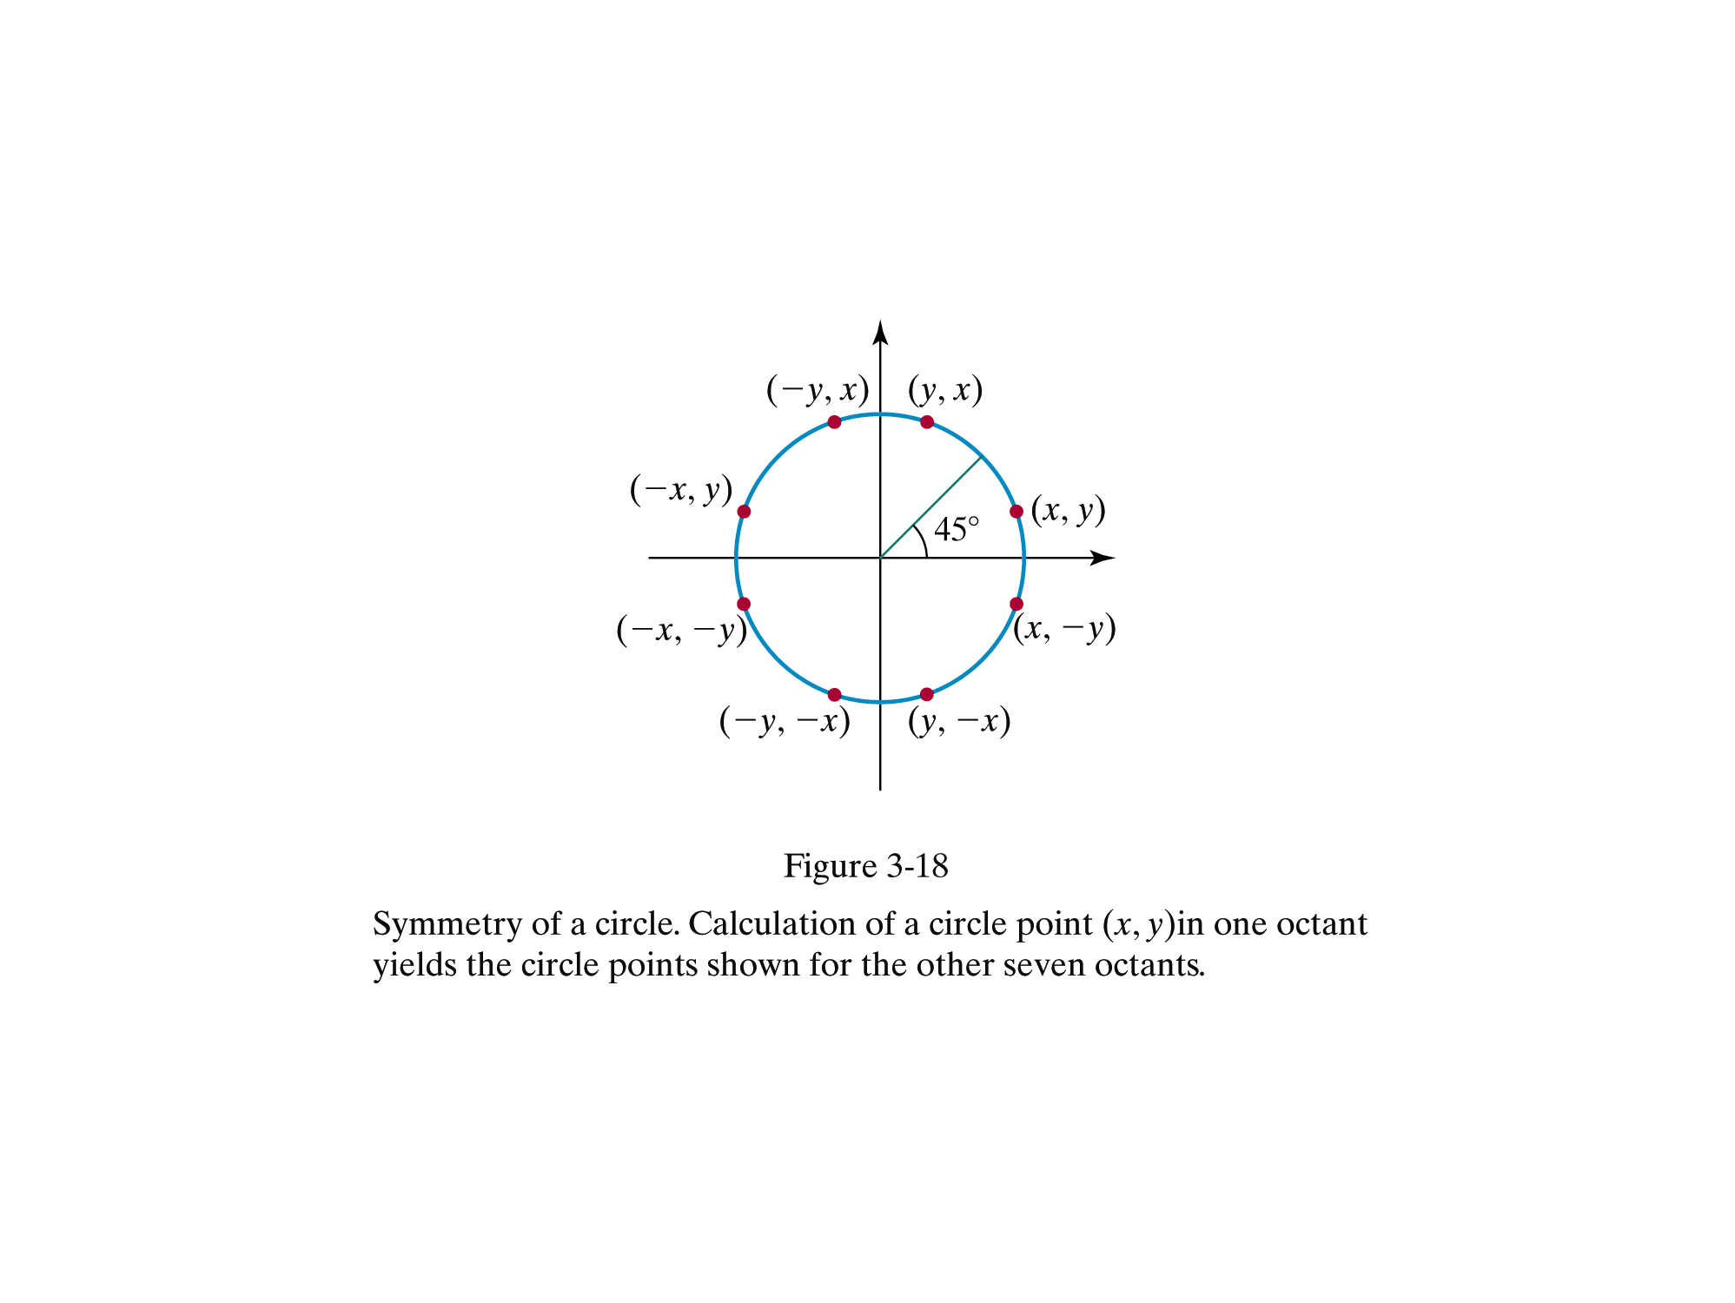

Slide 24
Generalising the Bresenham midpoint approach
Set up decision parameters for finding the closest pixel to the cırcumference at each sampling step
Avoid square root calculations by considering the squares of the pixel separation distances
Use direct comparison without squaring.
Adapt the midpoint test idea: test the halfway position between pixels to determine if this midpoint is inside or outside the curve
This gives the midpoint algorithm for circles
Can be adapted to other curves: conic sections

Slide 25
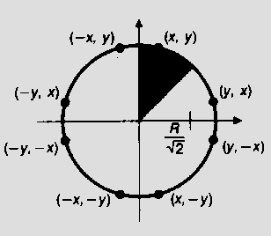
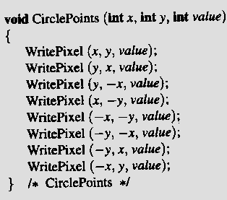
Eight-way Symmetry - only one octant’s calculation needed

Slide 26
The 2nd Octant is a good arc to draw
It is a well-defined function in this domain
single-valued
no vertical tangents: |slope|  1
Lends itself to the midpoint approach
only need consider E or SE
Implicit formulation F(x,y) = x ² + y ² – r ²
For (x,y) on the circle, F(x,y) = 0
F(x,y) > 0 ⇒ (x,y) Outside
F(x,y) < 0 ⇒ (x,y) Inside

Slide 27
Choose E or SE
Decision variable d is x ² + y ² – r ²
Then d = F(M)  0 ⇒ SE
Or d = F(M) < 0 ⇒ E

Slide 28
F (M)  0 ⇒ SE
current pixel
ideal curve

Slide 29
F (M) < 0 ⇒ E
ideal curve

Slide 30
Decision Variable p
As in the Bresenham line algorithm we use a decision variable to direct the selection of pixels.
Use the implicit form of the circle equation
p = F (M ) = x ² + y ² – r ²

Slide 31
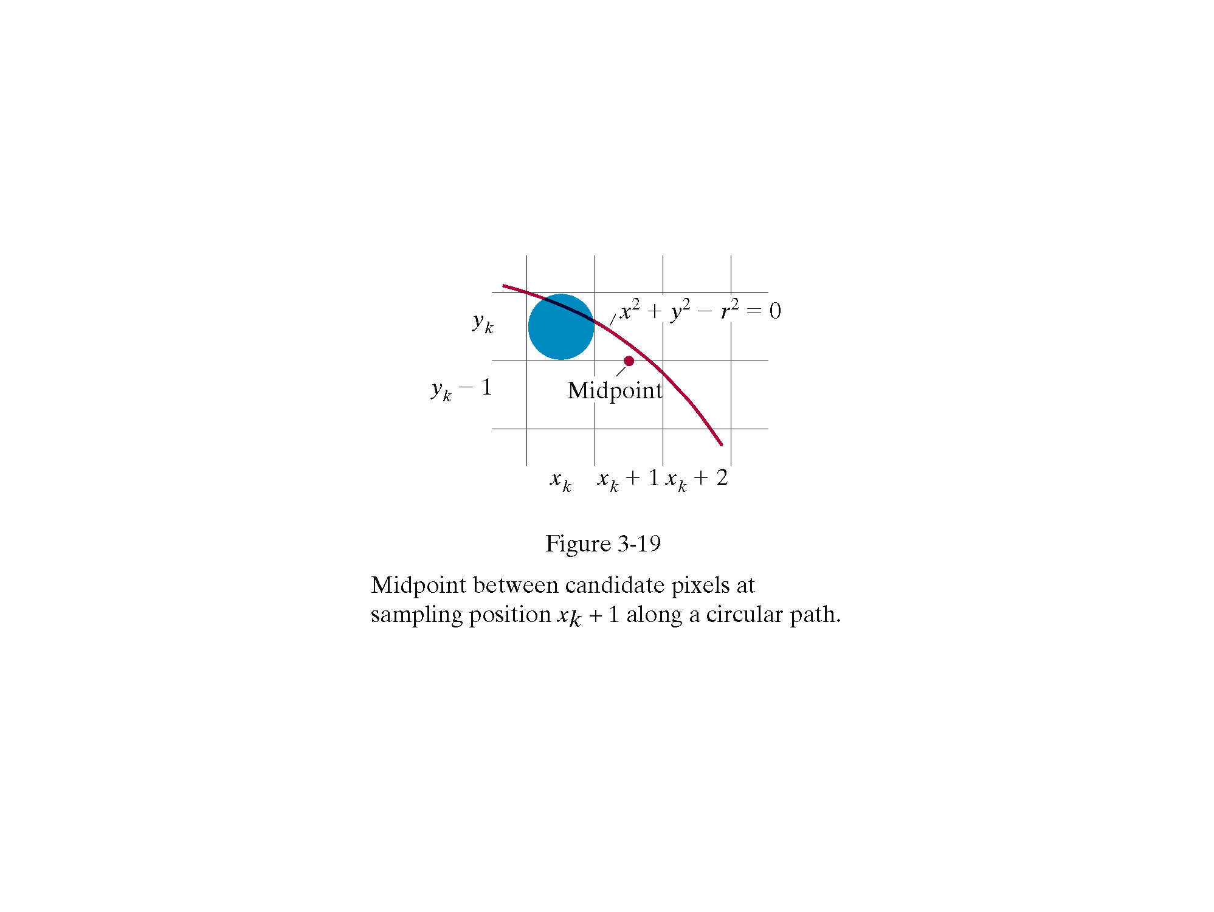
Midpoint coordinates are

Slide 32
Assuming we have just plotted point at (xk,yk) we determine whether move E or SE by evaluating the circle function at the midpoint between the two candidate pixel positions
pk is the decision variable
if pk <0 the midpoint is inside the circle
Thus the pixel above the midpoint is closer to the ideal circle, and we select pixel on scan line yk. i.e. Go E

Slide 33
If pk >0 the midpoint is outside the circle.
Thus the pixel below the midpoint is closer to the ideal circle, and we select pixel on scan line yk-1. i.e. Go SE
Calculate successive decision parameter values p by incremental calculations.

Slide 34
recursive definition for successive decision parameter values p
Where yk+1 = yk if p<0 (move E)
yk+1 = yk-1 if p>0 (move SE)
yk+1 and xk+1 can also be defined recursively

Slide 35
Initialisation
x₀ = 0, y₀ = r
Initial decision variable found by evaluating circle function at first midpoint test position
For integer radius r p₀ can be rounded to p₀ =1-r
since all increments are integer.

Slide 36
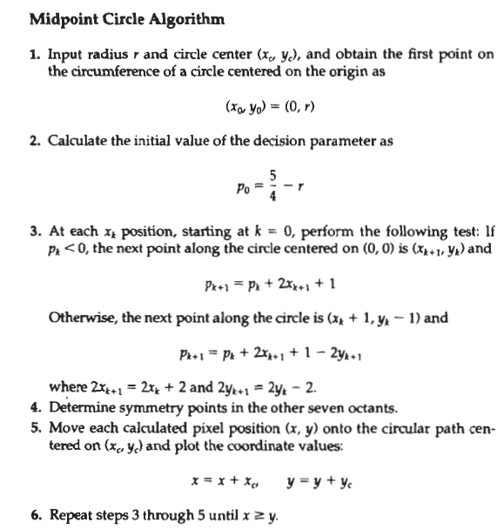

Slide 37
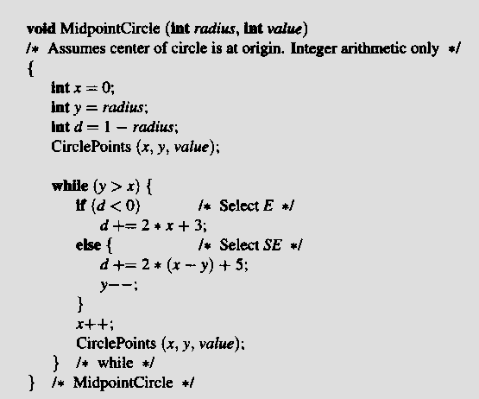
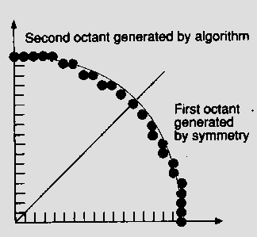
Midpoint Circle Algorithm (cont.)

Slide 38
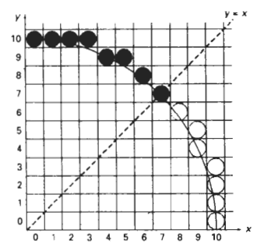
Example
r=10

Slide 39
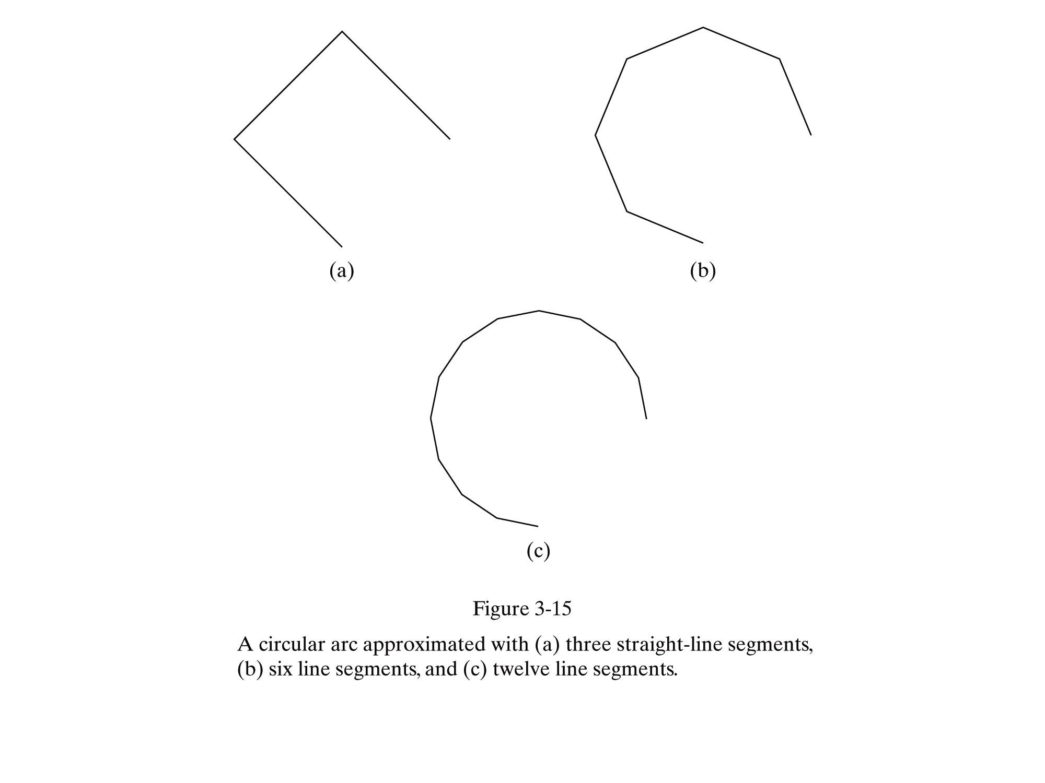
Another method: Approximate it using a polyline.

Slide 40
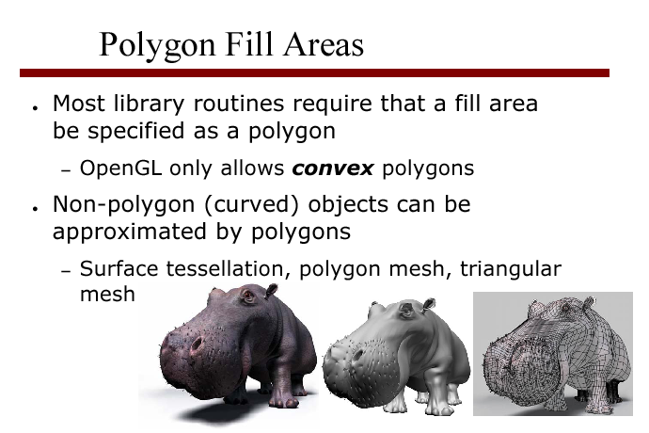
Fill area : an area that is filled with solid colour or pattern

Slide 41
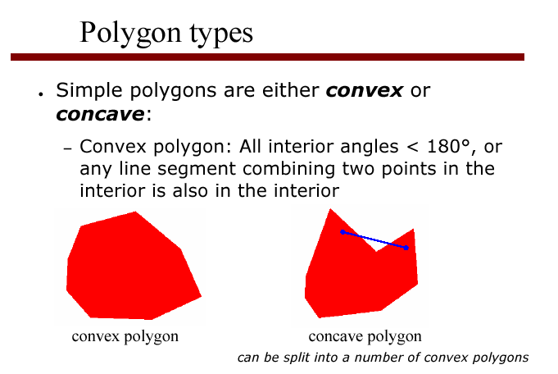

Slide 42
Identifying a concave polygon
has at least one interior angle >180 degrees
extensions of some edges will intersect other edges
One test:
Express each polygon edge as a vector, with a consistent orientation.
Can then calculate cross-products of adjacent edges

Slide 43
Identifying a concave polygon
When polygon edges are oriented with an anti-clockwise sense
cross product at convex vertex has positive sign
concave vertex gives negative sign

Slide 44
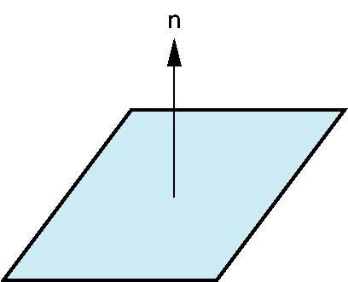
Normals
Every plane has a vector n normal (perpendicular, orthogonal) to it
n = u x v (vector cross product)
v
u
P

Slide 45
Vector method for splitting concave polygons
E₁=(1,0,0) E₂=(1,1,0)
E₃=(1,-1,0) E₄=(0,3,0)
E₅=(-3,0,0) E₆=(0,-3,0)
All z components have 0 value.
Cross product of two vectors E_{j}xE_{k} is perpendicular to them with z component
E_{jx}E_{ky}-E_{kx}E_{jy}
3
E₅
2
E₆
E₄
1
E₂
E₃
E₁
0
1
2
3

Slide 46
Example continued
E₁xE₂= (0,0,1) E₂xE₃= (0,0,-2) E₃xE₄= … E₄xE₅= …
E₅xE₆= … E₆xE₁= …
Since E₂xE₃ has negative sign, split the polygon along the line of vector E₂
3
E₅
2
E₆
E₄
1
E₂
E₃
E₁
0
1
2
3

Slide 47
Rotational method
Rotate the polygon so that each vertex in turn is at coordinate origin.
If following vertex is below the x axis, polygon is concave.
Split the polygon by x axis.

Slide 48
E₅
E₆
E₄
E₂
E₃
E₁

Slide 49
E₅
E₆
E₁
E₂
E₄
E₃

Slide 50
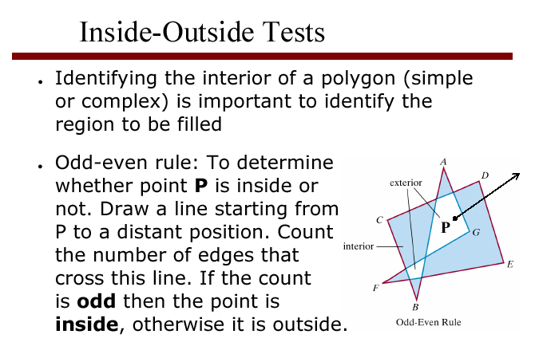

Slide 51
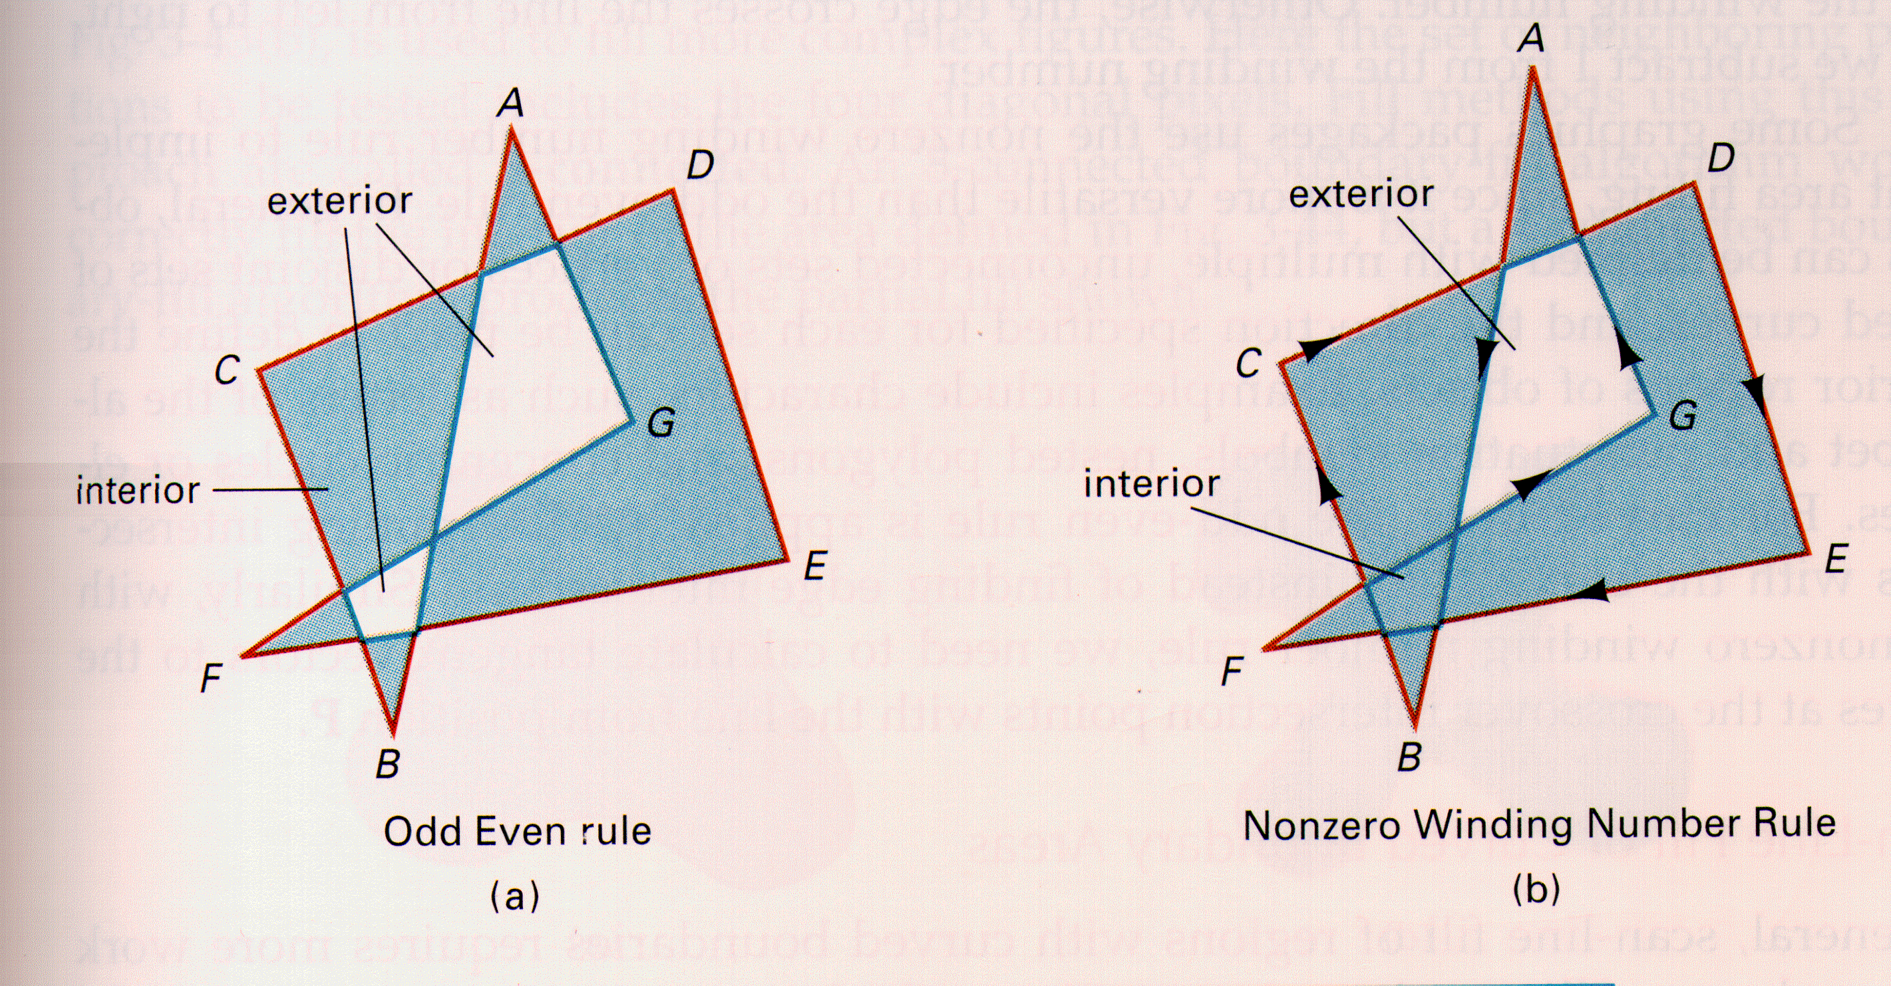
Inside-Outside? nonzero winding-number rule
A winding number is an attribute of a point with respect to a polygon that tells us how many times the polygon encloses (or wraps around) the point. It is an integer, greater than or equal to 0. Regions of winding number 0 (unenclosed) are obviously outside the polygon, and regions of winding number 1 (simply enclosed) are obviously inside the polygon.
Initially 0
+1: edge crossing the line from right to left
-1: left to right

Slide 52
Winding Number
Count clockwise encirclements of point
Alternate definition of inside: inside if winding number ≠ 0
winding number = 1
winding number = 2

Slide 53
Polygon tables
store descriptions of polygon geometry and topology, and surface parameters: colour, transparency, light-reflection
organise in 2 groups
geometric data
attribute data

Slide 54
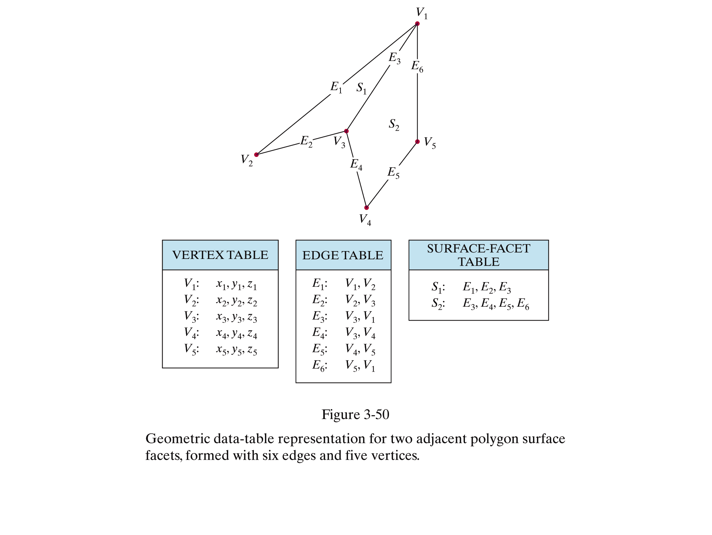
Polygon Tables:
Geometric data
Data can be used for consistency checking
Additional geometric data stored: slopes, bounding boxes

Slide 55
Shared Edges
Vertex lists will draw filled polygons correctly but if we draw the polygon by its edges, shared edges are drawn twice
Can store mesh by edge list

Slide 56
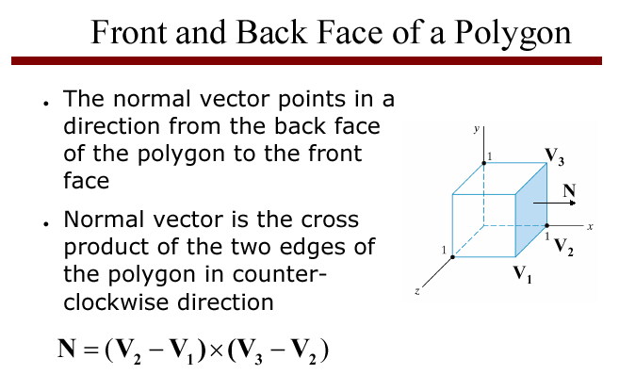

Slide 57
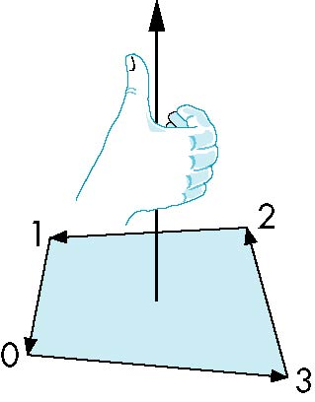
Inward and Outward Facing Polygons
The order {v₁, v₆, v₇} and {v₆, v₇, v₁} are equivalent in that the same polygon will be rendered by OpenGL but the order {v₁, v₇, v₆} is different
The first two describe outwardly
facing polygons
Use the right-hand rule =
counter-clockwise encirclement
of outward-pointing normal
OpenGL can treat inward and
outward facing polygons differently

